Slide 1
AudioSpace
Responsive Design

Slide 2
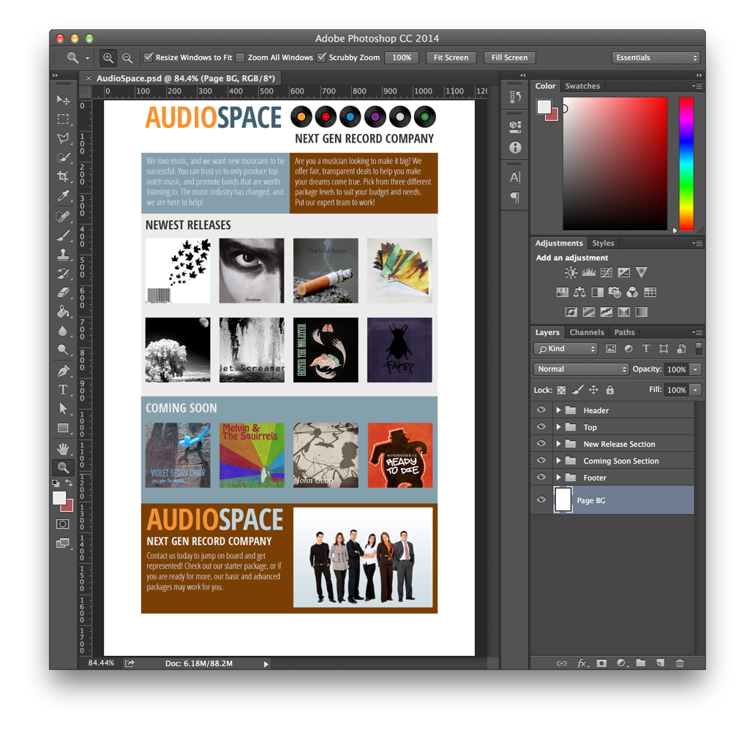
Our job is to take this design, which is fairly simple and do the html/css production work, as well as make it responsive.
At some point, as the screen size gets narrower, we will go from a layout with four columns to one with two columns.
This is not a terribly difficult design to code, but we will learn some great tricks along the way.

Slide 3
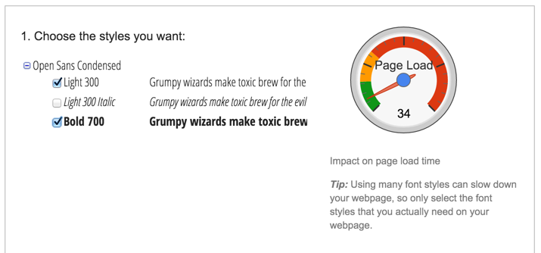
The first thing we will need is the font from Google Fonts that is used for the type in this design.

Slide 4
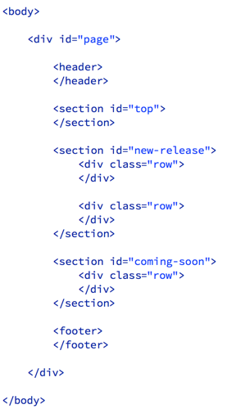
Since we are going to make this page responsive, we will need this meta tag to keep our mobile devices from zooming out. Add this to the top of the html file, between the head tags.
Then, let’s get the basic structure of the page marked up in HTML. You can see in the image on the right, I have a div with ID set to “page” that contains the whole page.
There is a header, a top section, a new release section with two rows, a coming soon section with one row and a footer.
It should not be too difficult to see how that describes the basic structure of the page.

Slide 5
On this page, I have some columns that are half the width of the page, and some that are one-quarter the width of the page.
I decided that the one-quarter width ones I would call a single column, while the half width ones are a double column.
The header has two images, each inside a double width column.

Slide 6
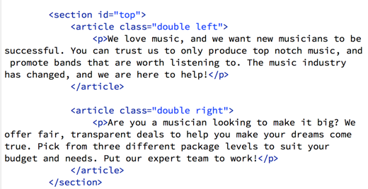
Inside the top section, I will add an article for each of the paragraphs of text. I will use the left and right classes to get the correct background color, when I get to the CSS.

Slide 7
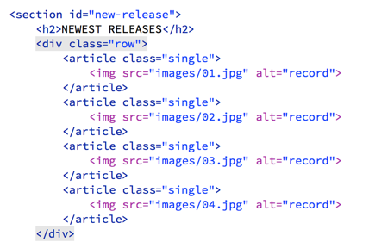
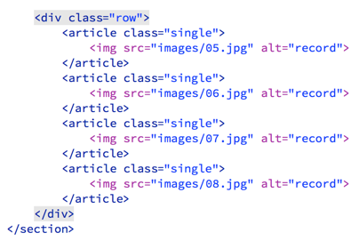
In the newest release section, I added the H2 at the top, and then inside each row, I added an article with the image of the album cover for each record.
I will use the class of singe to set the width of the column to 25% later in the CSS.
I put the markup that goes inside each row on the snippets, so you don’t have to type it all.

Slide 8
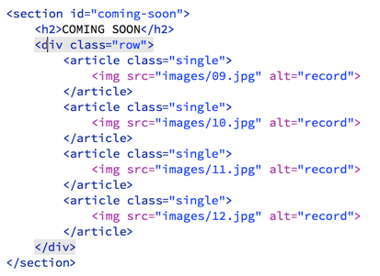
The coming soon section looks similar.

Slide 9
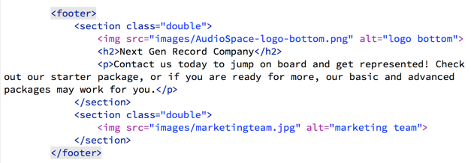
The markup for the footer is not too complicated. Just two more double wide sections and the markup for the content.
Now we have all the markup we need for the moment. Next we will get some of the styles we need in place.

Slide 10
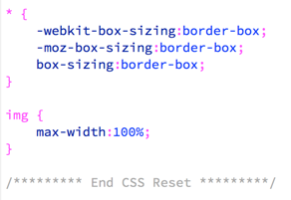
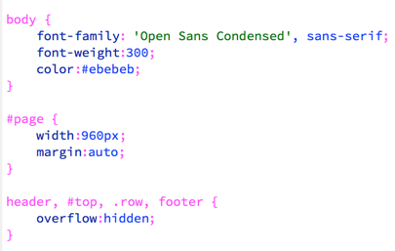
First, I will add these two rules to the CSS Reset that is already on the styles.css file. These two rules will reset the way the box model works on all elements, plus keep images from overrunning their containers.
After the CSS reset, we can add some rules for basic settings for the body and the page div.
Also, the header, #top, .row and footer elements are going to have floats in them, so we can set overflow:hidden on all of them to make them contain their floated elements.

Slide 11
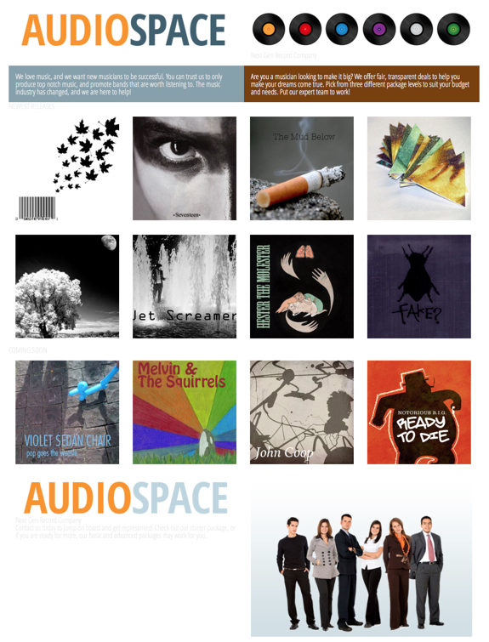
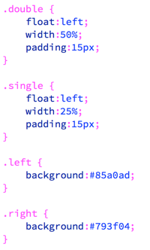
Add a few rules for the layout, and the design is already coming together...

Slide 12
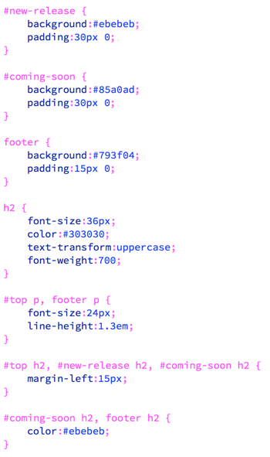
These basic rules will set the background colors, the padding and font sizes for the rest of the elements on the page. When we are done with these, our basic layout should be in place.

Slide 13
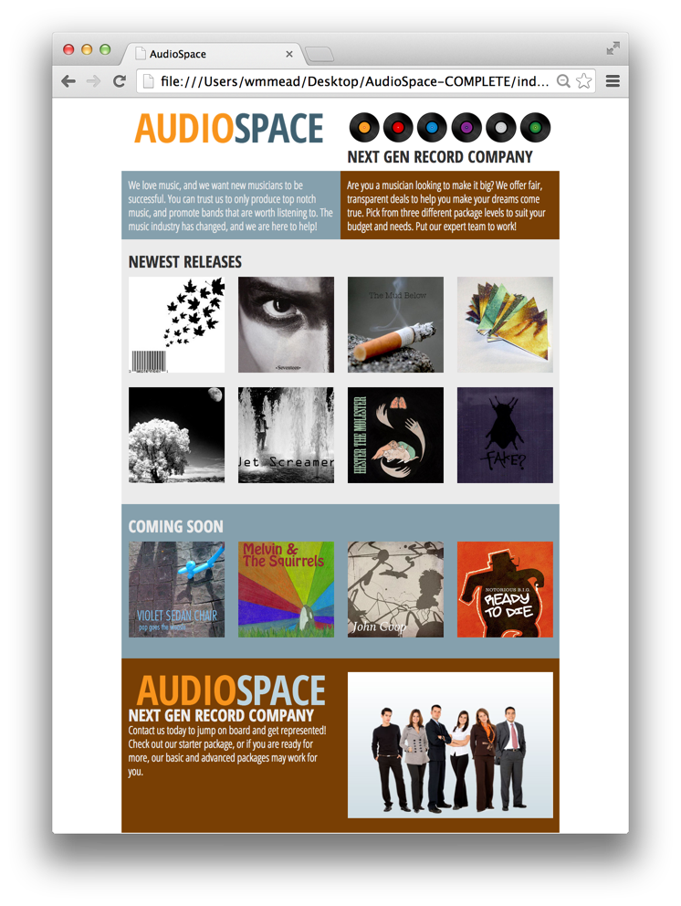
This is looking mostly ok. We could do something to get the logo images to position better, but I have another idea for that which we can try.

Slide 14
Before we try something with the logo, let’s get this basic media query in place and see what it does.
If you test it, you can see, right off the bat, that it is working pretty well.
Because the logo is an image, and we set images to not exceed the boundaries of their containers, it scales down as the space for it gets smaller.
However, wouldn’t it be cool if we could use HTML and CSS instead of an image for the logo?

Slide 15
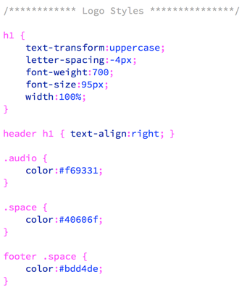
I replaced the images in the header and footer sections with this markup, which is simply an h1 tag with spans around each of the words so I can set the colors on them properly.
Then these styles, which I added to the the stylesheet before the media query will get the styling right for that text.

Slide 16
The problem is that, unlike image, text won’t naturally scale down if you make the container it is in smaller. What should I do about this? I could give up and just go back to the image. That would be a good enough solution. However, I don’t like to give up.
I found a great little JavaScript solution.
Add this to the bottom of the page, before the closing body tag.
For BOTH the h1 tags (in the header and footer) add the class “fittext”.

Slide 17
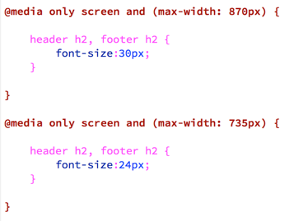
As I start to scale the page down, I notice that there are some elements that need to be resized a bit. These two media queries will help.
Also, as I scale the page down, I notice there are spots where the left and right columns at the top do not match up. I can easily fix this with a rule for the top that sets the background color to the brown on the right side. I put this rule towards the top of the stylesheet.

Slide 18
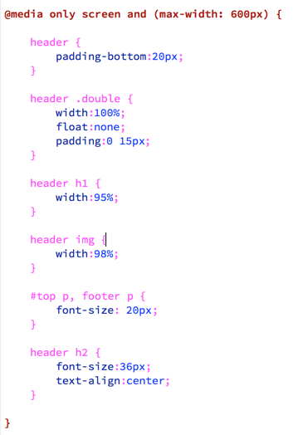
Once the width of the browser gets down to 600 pixels or less, we need to make some more adjustments.
The biggest change is that the top section will no longer be two columns.

Slide 19
The design is looking pretty good at a variety of screen sizes, and we are essentially done. But I found one other thing that I thought would be interesting to try.

Slide 20
I thought it would be cool to include the css card flip animation as described on this tutorial. You can find the tutorial here:
http://davidwalsh.name/css-flip

Slide 21
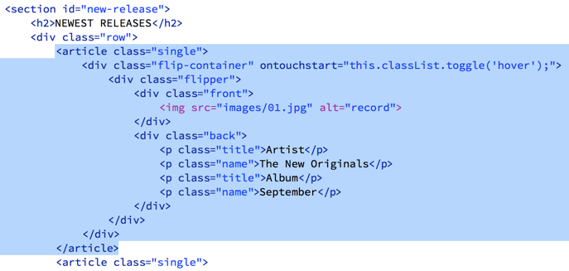
Maybe we can make it so that when you roll over one of the album covers, it flips over and shows some information about the album.
Let’s see if we can make it work.
Replace the markup for the first album with this. We will just do this one for now.

Slide 22
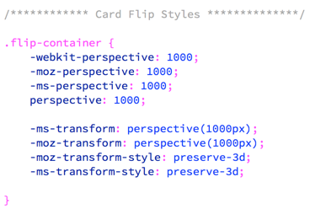
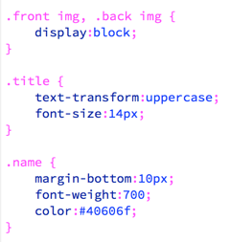
I added a whole mess of rules, pulled from the demo of the card flip tutorial made by David Walsh. This is just the first rule. There is a whole long stack, which you can copy from the snippets and add to the stylesheet, just before all the media queries (they should still be last).
The only ones I modified or added are at the bottom of the list. These will help style the back of the card. The rest are pretty much the same as what was in the demo.

Slide 23
It is working, but if you scale the page down a little you will notice there is a problem. The problem is that for this card flip effect to work, you must define the height of the containers.
As the size of the album gets smaller, the height also has to get smaller. Unfortunately setting height to 100% does not work. To fix this, I had to write just a little JavaScript.
First, remove the height declaration from the rule above and make it look like this.

Slide 24
Then add this bit of JavaScript to the bottom of the html file, just after the other scripts. This script gets the width of the single column elements and then sets the height to that same amount for the elements we need to set it for (.flip-container, .front and .back).
That works, but you will notice that if you resize the window, you will have to refresh the page to get the box to size properly. Really this should be enough, since people are not usually dragging their windows around, but it seems a little sloppy, so lets fix it.

Slide 25
Now it works properly at any size.
Now that we have one working, we can put in markup for all the others. Since this is a tedious and repetitive process, I put it all in the snippets for you.
Once you get that all in place, it should all be working.

